Slide 1
Prediction of California Wildfires Using GP Models
Analysis of risk factors and future prediction

Slide 2
California Wildfires Today & Motivations
Climate change and wildfires
Thomas fire: high temperature, windy and dry
Notes:
Destroyed area larger than NYC and 20% contained
One acre per second
Fires happening this year are some of the most destructive ever

Slide 3
Assumptions and Methods
Wildfire independence
Different wildfires have location / no local based correspondence
Different wildfires have no time based correspondence (Extensions possibility)
Weather data
We build our models only with weather data
Only include weather data from possible wildfire locations (ex. downtown SF or LA are not included)
Single weather point for each fire
Fires are natural phenomenon
Usually caused by human impact or lightning

Slide 4
Data
Weather
Darksky.net
Latitude, Longitude, Wind speed, temperature hi, temp low, humidity, pressure, cloud cover, precip intensity
Shape/Location
CAL Fire website ds396
Latitude, Longitude, Geometry (compute center), size
(Cortez & Morais, 2007)
Useful parameters for fire prediction are: wind speed, temperature, humidity and precipitation
Notes:
Ease of implementation and extension
Forecastable

Slide 5
Labels
Fire classification as loose outlier detection (labels: 0, 1)
We use classification methods with ratio 6:1 negative to positive
P(wildfire | day) is low for all days, but P(wildfire | month) is much higher.
“Perfect storm” of events. Need applicable day and good start event
Fire size regression
Target is the size of the fire.

Slide 6
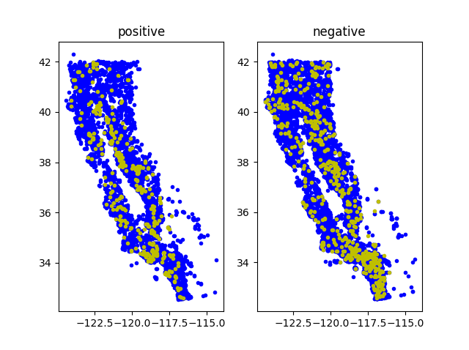
Data Statistics
Training Dataset (2000 - 2015):
4577 positive, 10863 negative.
Testing Dataset (2016):
344 positive, 531 negative.

Slide 7
Methods
Linear Classifier (LC)
Neural Network (NN)
Input feature - 5 - 3 - output
Sigmoid activation function
Support Vector Machine (SVM)
RBF kernel
Random Forest (RF)
100 base classifiers
Gaussian Process GP
0 mean function
Linear Classifier mean function
Neural Network mean function

Slide 8
Experiments - toolkits
Scikit Learn
LC, SVM, RF
Tensorflow
NN
GPflow
GP

Slide 9
Results - Prediction without location
LC and SVM are better models.
GP model failed to capture as much as information compared with others.
 | LC | NN | SVM | RF | GP
Accuracy | 83.20 | 83.31 | 83.54 | 83.20 | 82.63
TP rate | 72.97 | 70.64 | 72.09 | 70.64 | 68.60

Slide 10
Results - Feature importance
Linear Classifier interprets features well.
Beyond previous literature, pressure is also a good indicator.

Slide 11
Results - Prediction with location
LC and NN did not explain the location information well.
GP model becomes the best one!
 | LC | NN | SVM | RF | GP
Accuracy | 84.22 | 85.60 | 87.31 | 86.97 | 87.89
TP rate | 72.09 | 72.38 | 75.29 | 76.16 | 75.58

Slide 12
Results – GP with different mean function
Provide prior information for GP.
Both prior improved the predicting accuracy and TP rate.
GP + LC is the best model in our experiments.
 | GP (0) | GP (LC) | GP (NN)
Accuracy | 87.89 | 88.34 | 88.00
TP rate | 75.58 | 75.87 | 75.87

Slide 13
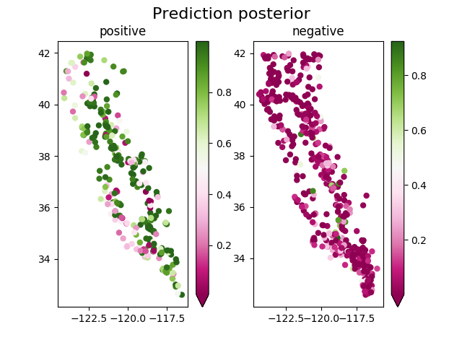
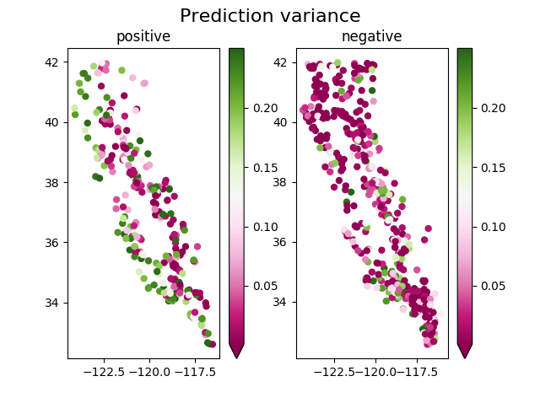
Results – Distribution of predictions (GP + LC)

Slide 14
Results – predicting the fire areas?
No
We built the model with Linear Regression, Neural Network, SVM and GP.
Best prediction: Coefficient of determination (R²) < 0.1.

Slide 15
Discussion & Extensions
Potential energy
Fire fuel gets burned off each time
GP
Fire size prediction and regression
Weather data improvements
Humidity over time
Wind speed during fire
Geospatial data and forest contours
Other field-based datasets

